Slide 1
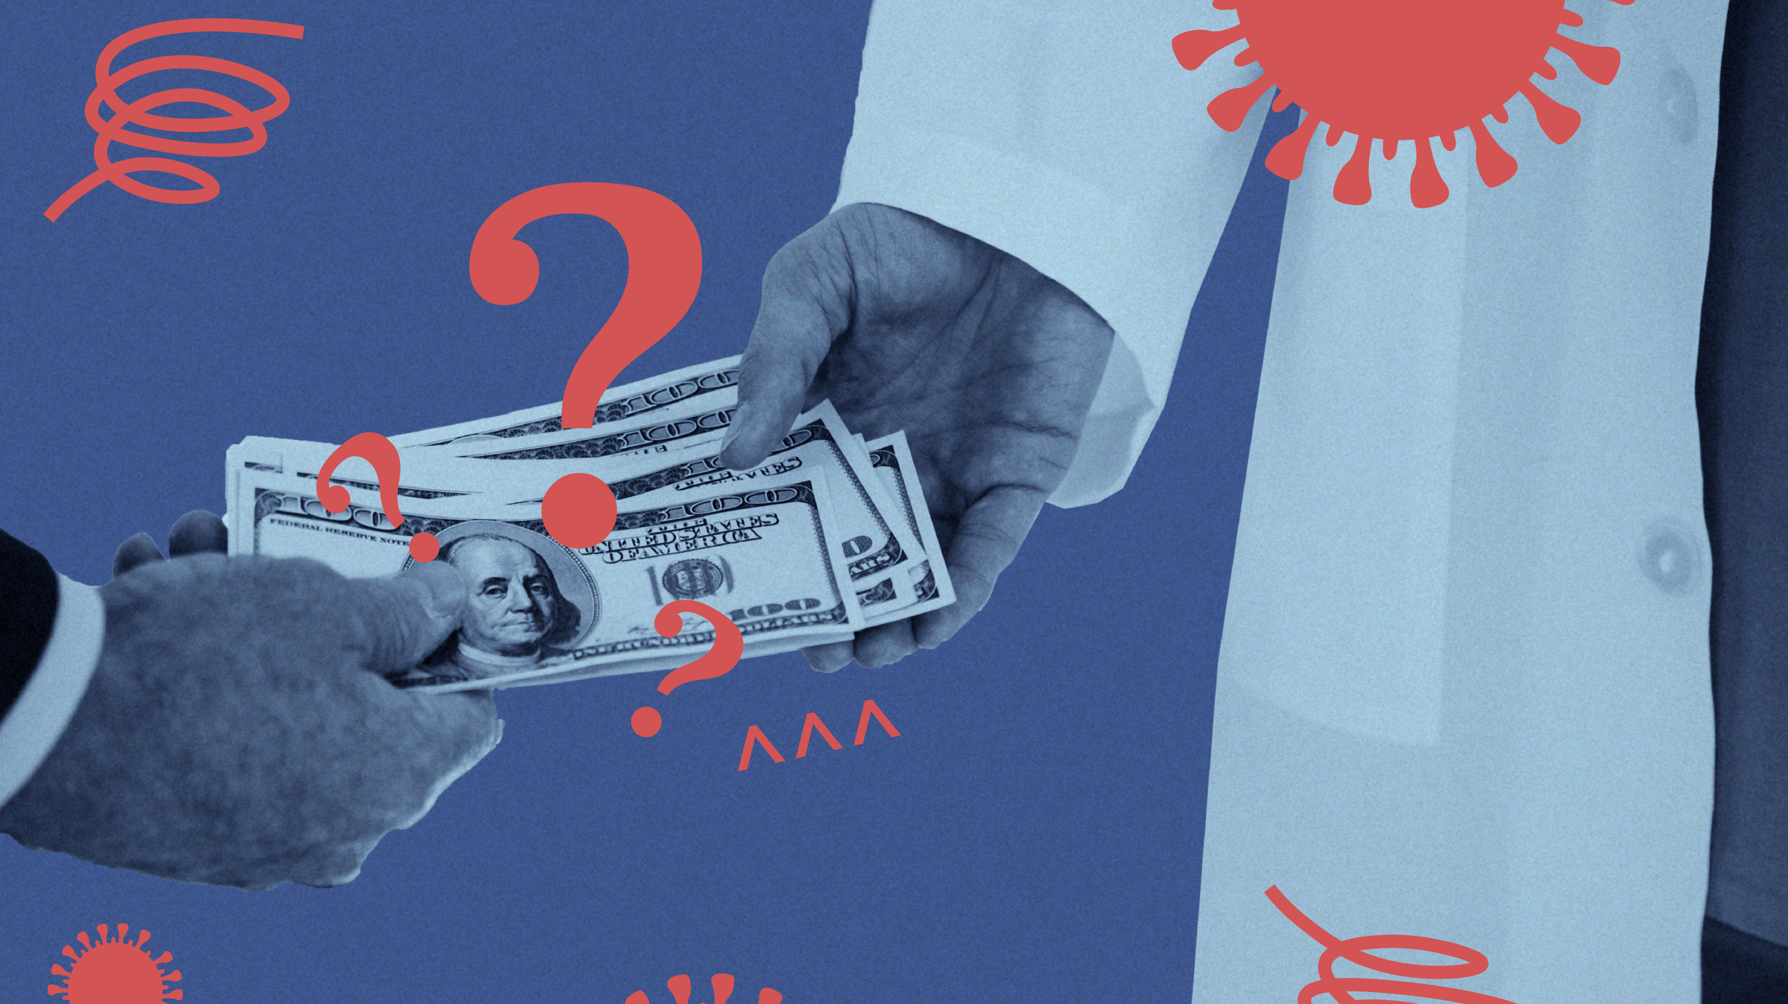
Bailout Money Amount Problems in Covid-19
BaIlout Money SuffIcIency DurIng Shutdowns

Slide 2
Covid-19 is a worlwide pandemic. Because of this pandemic a lot people died, and a lot of people got infected. Since this virus can rapidly spread, everybody tries to protect himself, and also everybody tries to strengthen his immune system to be able to fight against virus.
These are mainly about pandemic's health effects. On the other hand, there is a big economic effect of this pandemic over the people.
Because of Covid-19 pandemic, almost every economic activity either stopped, or slowed down. This means, in different economic areas commerce volume decreased.
Unfortunately, a lot of employees got fired. That means, fired people needed to get some financial help during pandemic.

Slide 3
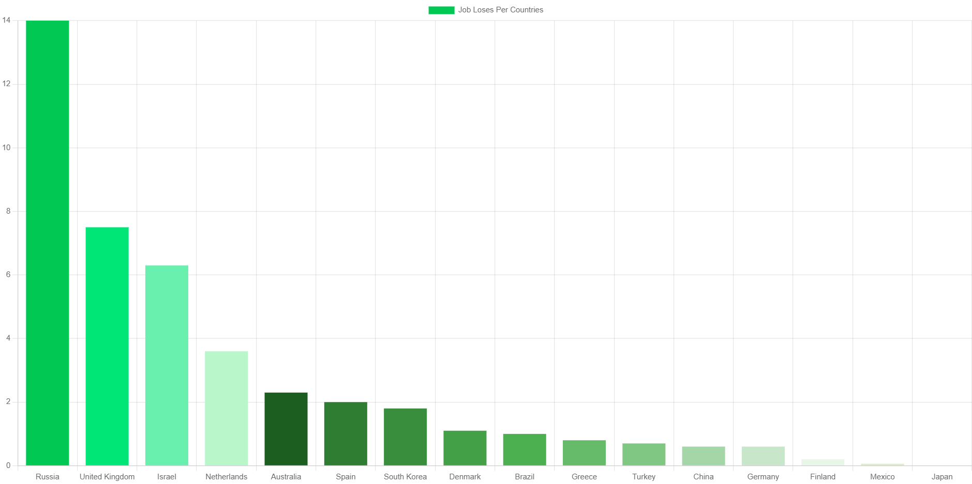

Slide 4
After Covid-19 spreaded quickly, countries understood that this is a serious pandemic which affects whole world. Therefore, a lot countries decided to go shutdown. Shutdown or lockdown means every population must be in quarantine in their houses. They thought that we can get rid of this pandemic in this way. Even though shutdown is a good solution to prevent fast spread of the virus, it occurred some economic needs.
My research problem is about countries bailout packages during mainly shutdowns. Due to Covid-19 virus, a lot of countries decided to go lockdowns. That means, those countries was supposed to be in quarantine for many days.

Slide 5
In those quarantine days, especially private sector employees, and craftpersons were affected because businesses couldn't run.
Because of this reason, the countries that decided to go shutdown announced bailout packages.
Some of the countries bailout package amounts are enough to stay in quarantine by not working. On the other hand, the other countries bailout package amounts are not enough to stay in quarantine by not working. This causes some serious economic depression in houses.

Slide 6
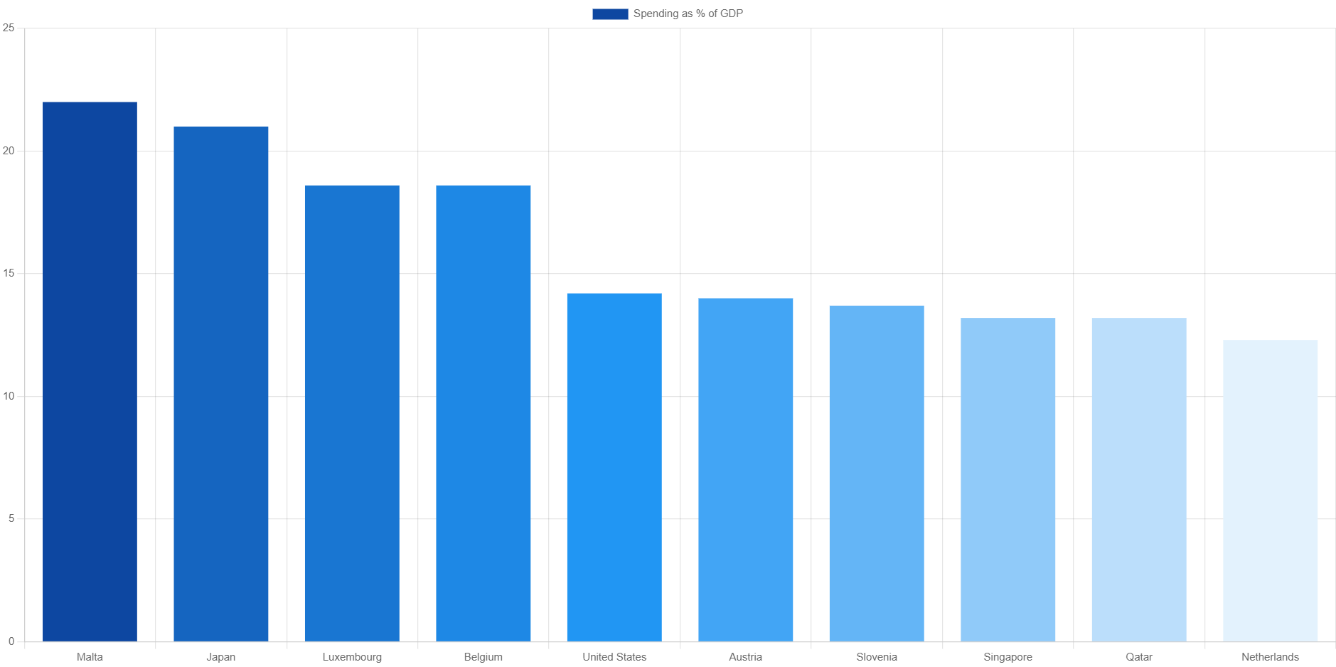

Slide 7
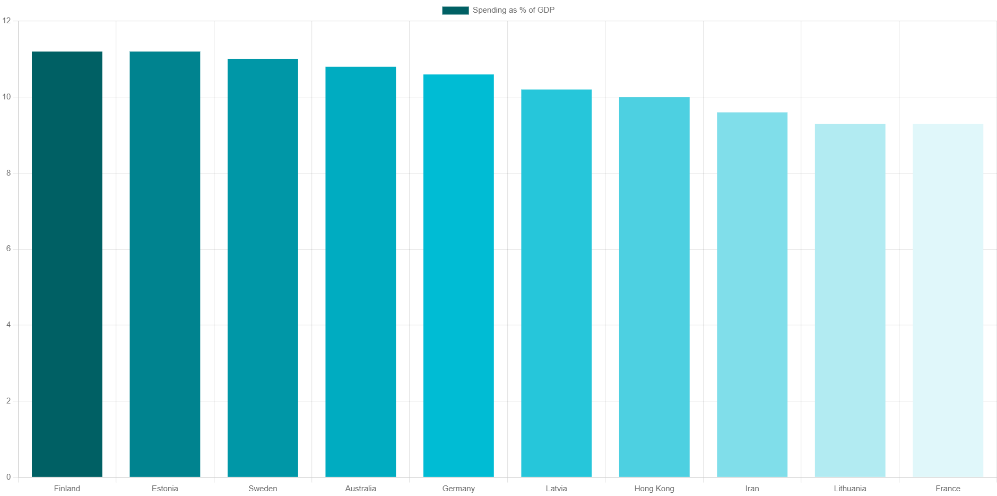

Slide 8
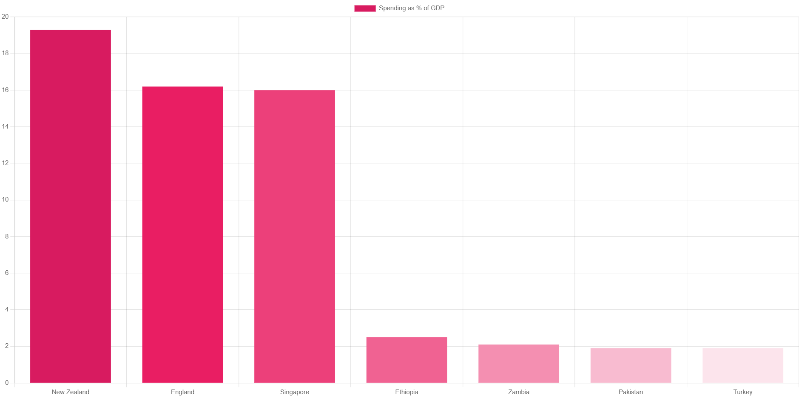

Slide 9
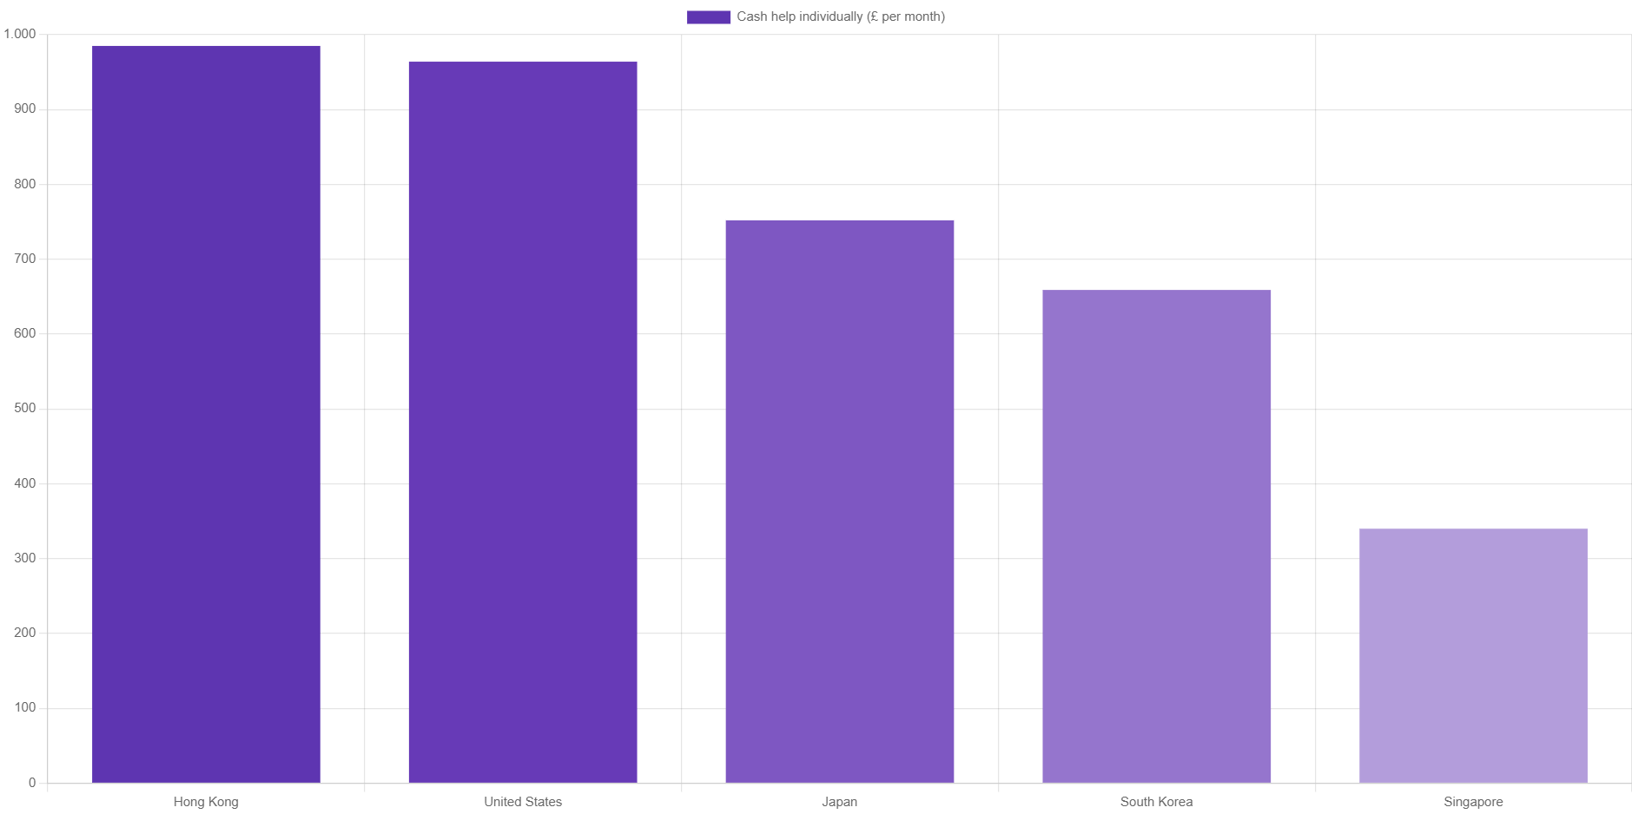

Slide 10
On these charts, it’s clearly seen that some of the countries bailout money amounts are good, and enough to help the people who are suffered from shutdowns. Such as Malta, Japan, Luxembourg, Belgium, and United States (for the updated data 1st).
On the other hand, the rest of the world countries bailout money amounts are either insufficient, or none. This occurred many economic, and psychological problem in houses.
According to a social state understanding, the states have to help their people. Otherwise, the taxes that taken from citizens don’t help the people.
Due to these little amount of bailout money, a lot of countries people got suffered from this pandemic, and these shutdowns. Unfortunately, in my country that is Turkey, %1,9 of GDP was given to the people. This amount of bailout money didn’t heal the wounds.

